Slide 1
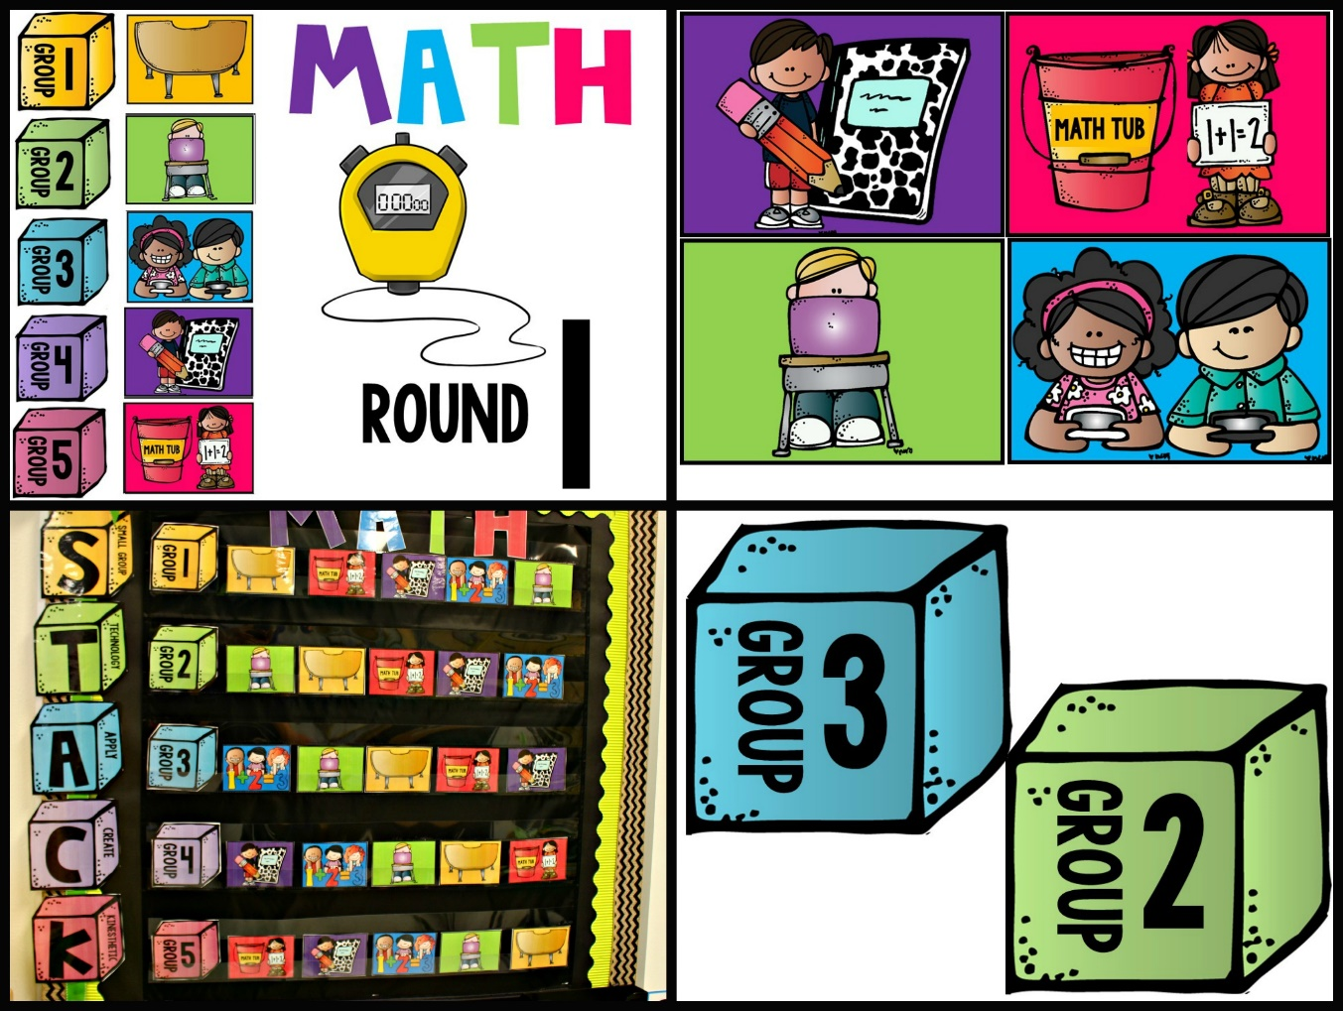

Slide 2
s
small
group

Slide 3
t
technology

Slide 4
a
apply

Slide 5
c
create

Slide 6
k
kinesthetic

Slide 7
s
Super Facts

Slide 8
1
group
1
round

Slide 9
2
group
2
round

Slide 10
3
group
3
round

Slide 11
4
group
4
round

Slide 12
5
group
5
round

Slide 13
6
group
6
round

Slide 14
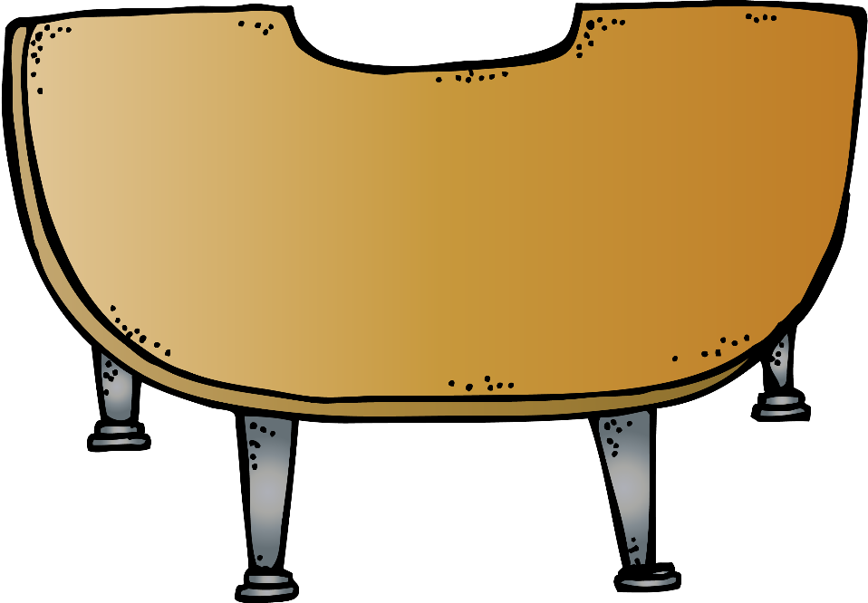

Slide 17
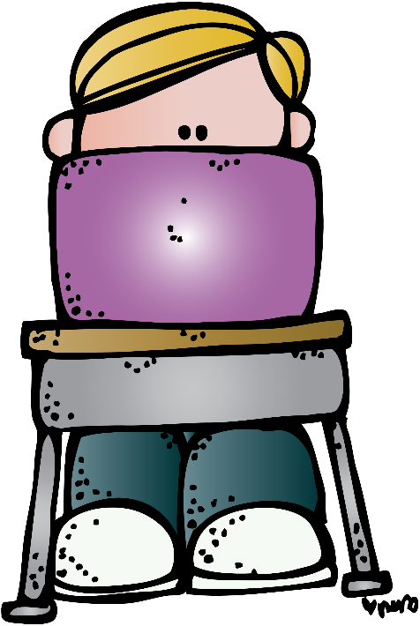

Slide 18
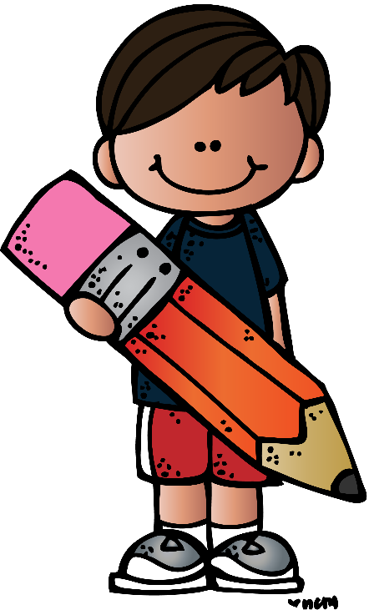

Slide 19
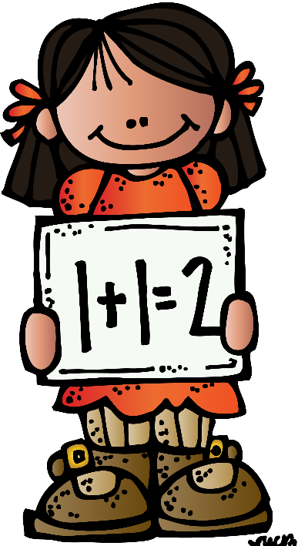
Math tub
Math tub
Math tub
Math tub

Slide 21
Math tub

Slide 23
MATH
1
round
6
group

Slide 24
MATH
2
round
6
group

Slide 25
MATH
3
round
6
group

Slide 26
MATH
4
round
6
group

Slide 27
MATH
5
round
6
group

Slide 28
MATH
6
round
6
group

Slide 29
Thank You!
I hope you enjoy using this packet in your classroom! You have bought the rights to use this packet in a single classroom.
If you plan to share this packet you will need to purchase a multiple classroom license on TPT,
=credits=
©2014Tunstall’sTeachingTidbits

